Slide 1

MAGE.ai
https://medium.com/@eponkratova/airflow-is-not-an-etl-tool-bfa82d20f31e

Slide 2
개발환경
Python download
VS Code download
activate Virtual Environment

Slide 3
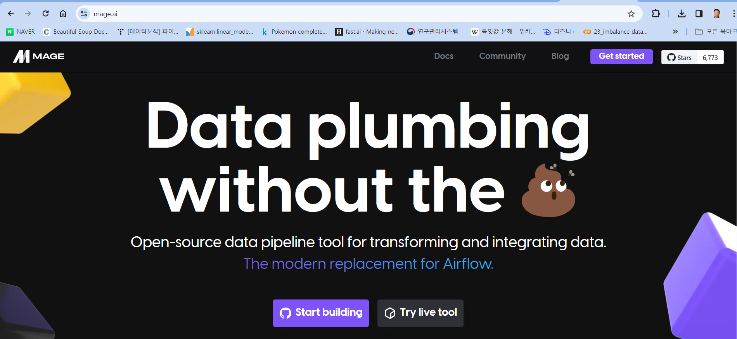
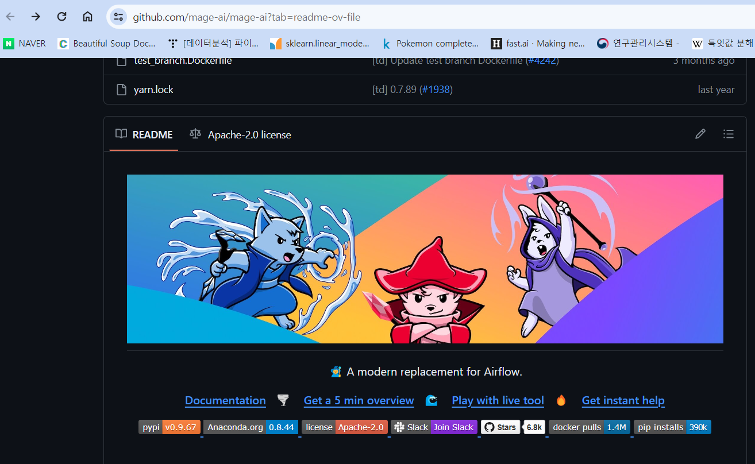
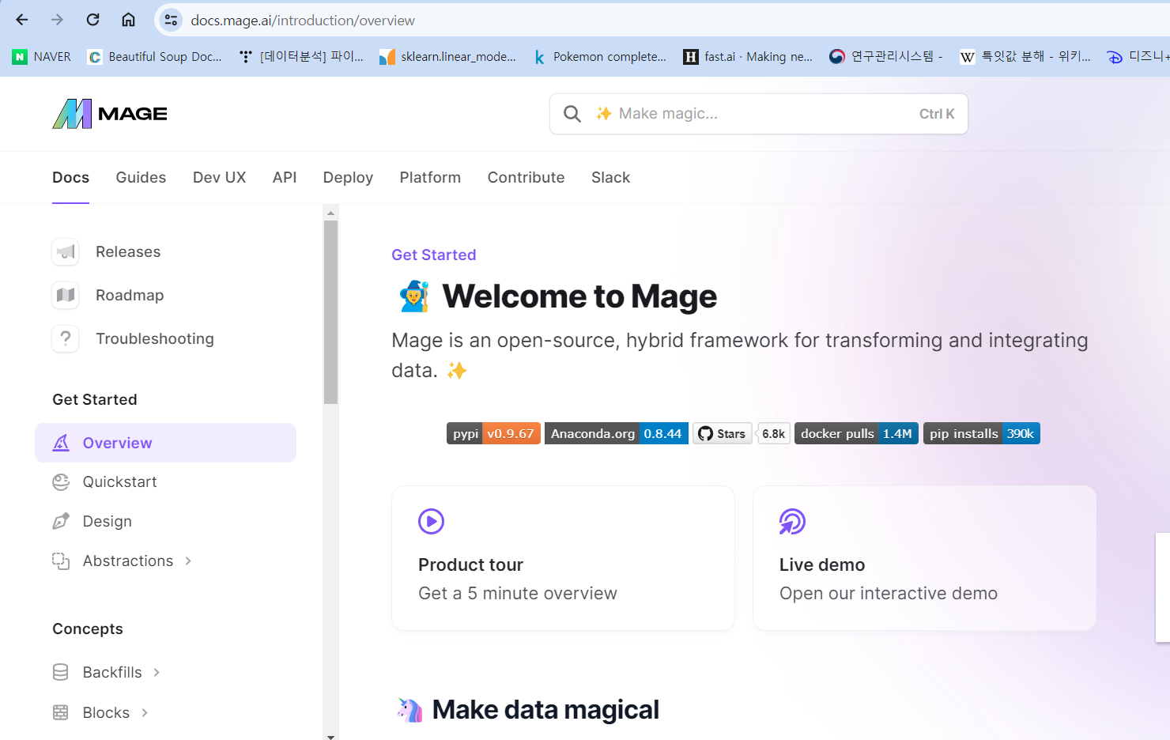
mage.ai

Slide 4
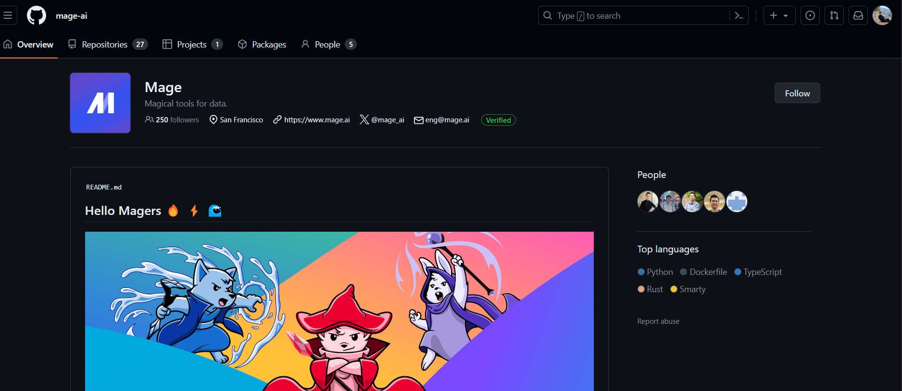
mage.ai

Slide 5
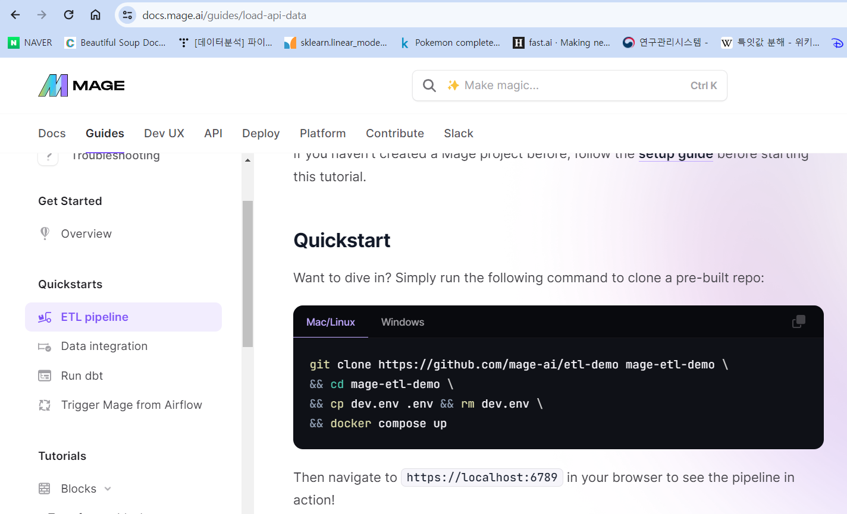

Quickstart to mage.ai

Slide 6

실습하기
WSL installation

Slide 7

load data.py
import io
import pandas as pd
import requests
if 'data_loader' not in globals():
from mage_ai.data_preparation.decorators import data_loader
if 'test' not in globals():
from mage_ai.data_preparation.decorators import test
@data_loader
def load_data_from_api(*args, **kwargs):
"""
Template for loading data from API
"""
url = 'https://raw.githubusercontent.com/mage-ai/datasets/master/restaurant_user_transactions.csv'
response = requests.get(url)
df = pd.read_csv(io.StringIO(response.text), sep=',')
print(df)
return df
@test
def test_output(df, *args) -> None:
"""
Template code for testing the output of the block.
"""
assert df is not None, 'The output is undefined'
assert len(df.index) >= 1000, 'The data does not have enough rows.'

Slide 8
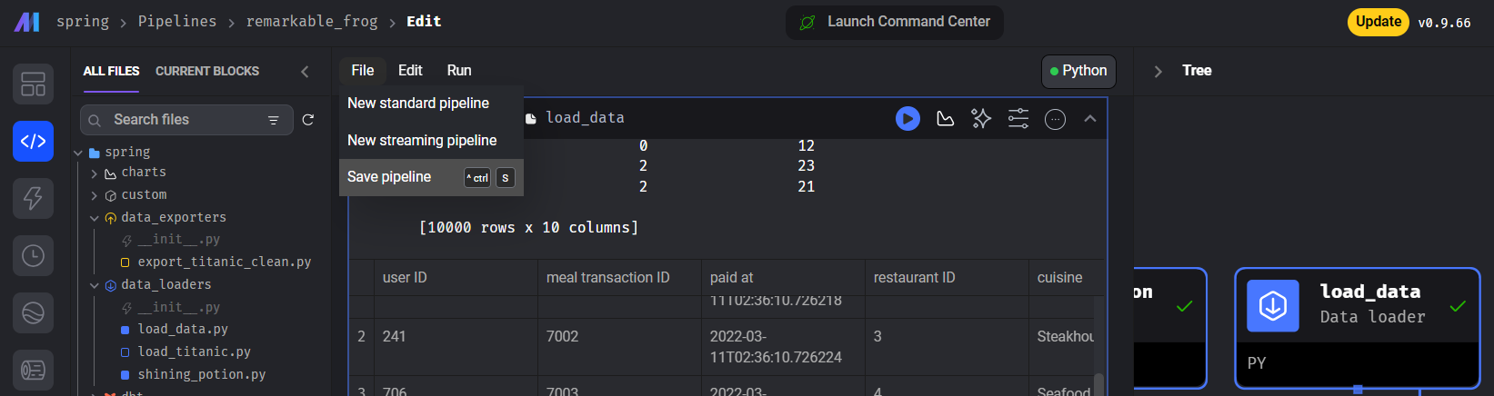
load data.py
File > Save pipeline, 단축키 “ctrl + s”

Slide 9

export_data_to_csv_file.py
from mage_ai.io.file import FileIO
from pandas import DataFrame
if 'data_exporter' not in globals():
from mage_ai.data_preparation.decorators import data_exporter
@data_exporter
def export_data_to_file(df: DataFrame, **kwargs) -> None:
"""
Template for exporting data to filesystem.
Docs: https://docs.mage.ai/design/data-loading#fileio
"""
# Use forward slashes for file paths or double backslashes, and provide a full filename including the extension.
filepath = '../data_to_export.csv' # Adjusted the file path to be more cross-platform friendly.
# The FileIO.export method defaults to exporting the file to CSV format if the extension is .csv.
FileIO().export(df, filepath)

Slide 10
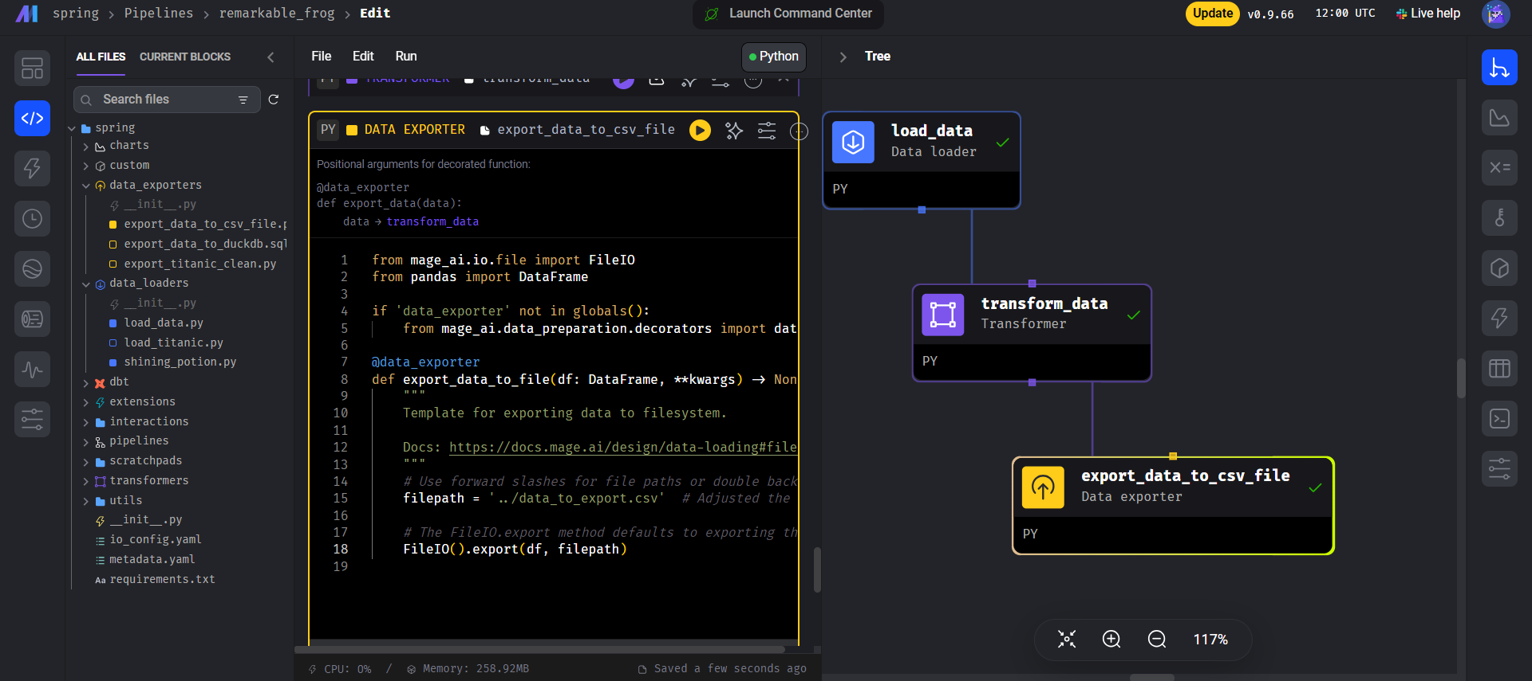
export_data_to_csv_file.py

Slide 11

과제 - 3

Slide 12
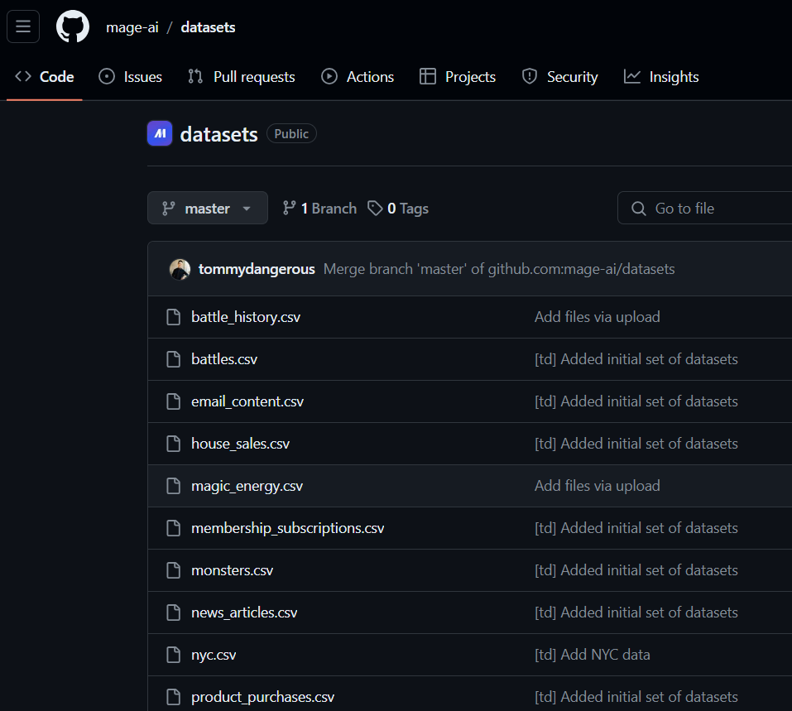
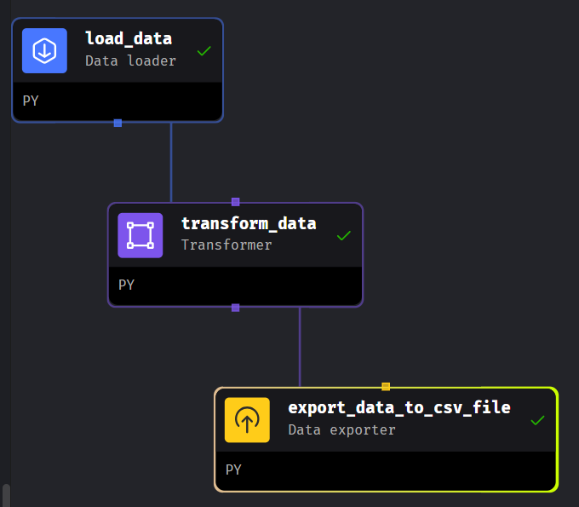
과제 제출

